Slide 1




Connecting Officer
Job Pack

Slide 2


Dear Applicant
Thank you for your interest in working for the HertsHelp Service, delivered by the Hertfordshire Advice Providers Partnership.
This job pack should give you everything you need to know to apply for this role and what it means to work with us.
In this pack you’ll find:
• Information about HertsHelp
• Purpose of the job
• Job description and person specification
• Interview and Application Process
• Candidate guidance notes
Want to chat about this role?
If you want to chat about the role further, contact recruitment@hertshelp.net to arrange an informal conversation
We look forward to hearing from you!
Giorgina Courtney
HertsHelp Service and Development Manager

Slide 3
Connecting Officer
Reporting to:
Team Leader
Department:
HertsHelp
Salary:
£23,809.50 to £24,500 DOE
Hours:
37.5 ( Fixed Term Contact until 31/03/2026)
This is a 7-day week service , weekends are worked via rota system covering 9 am to 7 pm weekdays and 10 am to 4 pm weekends.
Holidays:
27 + bank holidays
Purpose of post
Purpose of the Job
Working within the aims, policies, and principles of the HertsHelp Service, to support clients with a range of issues, providing information, signposting and referrals via telephone and email.
The successful candidate will complete necessary training to provide holistic information, signposting, and referrals on a range of issues.

Slide 4
Job Description | What you will be doing
Providing a high-quality information service to residents | Interview clients using sensitive listening and questioning skills to allow clients to explain their problem(s) and empower them to set their own priorities. Respond to telephone enquiries/ community enquiries by allowing callers to clarify their information needs, meeting their needs, and advising on the use of information given. Use trusted resources to find, interpret and communicate the relevant information. Provide information on all main enquiry areas. Facilitate crisis support. Make signposts and referrals to any necessary agencies/partners to support residents to get the help they need. Ensure information is easily accessible to all residents. Coordinate the information, signposting, and referral systems in line with policy and working in partnership with colleagues. Help maintain the database about all subjects relevant to supporting residents with their enquiries. Ensure that all information given to enquirers is accurate, current and in a style which is accessible and usable to a wide range of people. Respond to written enquiries in an accurate and concise manner. Respect the confidentiality of clients and their rights to make their own decisions. Manage the computer/telephony systems in line with the requirements/policies. |  | Maintain a monitoring service for the organisation by collecting statistical information about callers and enquiries to allow for development and evaluation of the service. Develop a fully integrated internal information system to ensure staff and volunteers are fully aware of material available and how to access it. Work with other members of staff to identify the information/signposting/referral needs of the residents and how to improve the availability of this material. Become familiar with, and utilise, all the resources available from trusted sources. Undertake specific short-term projects as identified e.g., government initiatives, local events, or issues. Carry out other relevant work as agreed with the line manager. Ensure that all work conforms to the organisation’s office manual / Service Delivery Manual and the Advice Quality standard. Maintain accurate, detailed records for the purpose of continuity of service, information retrieval, statistical monitoring, and report preparation.

Slide 5
Job Description | What you will be doing
Administration | Ensure that all work conforms to the organisation’s office manual / Service Delivery Manual and the Advice Quality standard. Maintain accurate, detailed records for the purpose of continuity of service, information retrieval, statistical monitoring, and report preparation. Use IT for statistical recording, record keeping and document production. Ensure all work conforms to the organisation’s systems and procedures. | Public Relations | Maintain close liaison with relevant external agencies. Liaise wit statutory and non-statutory organisations and uphold the values, aims and objectives of the service. Liaise with other voluntary, and statutory organisations, to help provide a comprehensive information signposting and referral service for the community.
Training & professional development | Successfully complete mandatory induction training. Successfully complete all training relevant to carrying out your role. Attend learning events and carry out learning activities in line with continuing professional development requirements. Keep up to date with legislation, policies and procedures relating to successful delivery of the service and attend appropriate training. | Other duties/ responsibilities | Carry out any other tasks that may be within the scope of the post to ensure the effective delivery and development of the service. Demonstrate commitment to the aims and policies of Citizens Advice Stevenage. Abide by health and safety guidelines and share responsibility for own safety and that of colleagues.

Slide 6
Person Specification | What you need to do this job
Organisational skills, with the ability to manage a workload and prioritise tasks, working to deadlines using own initiative. Taking an ordered approach to workload. An ability and willingness to follow and develop agreed procedures.
Knowledge and experience of providing information/support to people to help them.
Communication skills. The ability to communicate effectively, both orally and in writing, both with your colleagues and with a particular emphasis on sensitively and effectively interviewing clients.
Ability to build rapport with clients and provide non-judgemental information, signposting, and onward referrals.
Writing skills with particular emphasis on recording case notes, summarising support given to clients and corresponding with third parties on behalf of our clients.
Ability to use IT systems in the provision of information/signposting/referral and crisis support and the preparation of case records and reports.
Ability to give and receive feedback objectively and sensitively and a willingness to challenge constructively.
Ability and willingness to work as part of a team.
Ability to monitor and maintain own standards.
A commitment to continuous professional development.
Understanding of and commitment to the aims and principles of Citizens Advice Stevenage and its equality and diversity policies.
Willingness to commit to a high level of training. Identify own training needs and participate in continued personal development opportunities.
Able to adapt to meet the needs of the service.

Slide 7
Application Process
To apply please send your CV and concise supporting statement which includes examples and evidence demonstrating why you are suitable for this role, we recommend using the person specification as a guide. If you do not complete a supporting statement, your application may be rejected.
Clearly state your address, e-mail address, telephone number and whether you have a driving licence and whether you own a vehicle.
Applications should be submitted to recruitment@hertshelp.net
We are an equal-opportunity employer. If you have any requirements (e.g., for attending an interview) please note these clearly in your letter.
Interview Process
The closing date is: 13/04/2025
Shortlisted candidates will be contacted by telephone, so please give a daytime
telephone number or somewhere we can leave a message to arrange an interview.
Offers made are subject to 2 satisfactory references

Slide 8
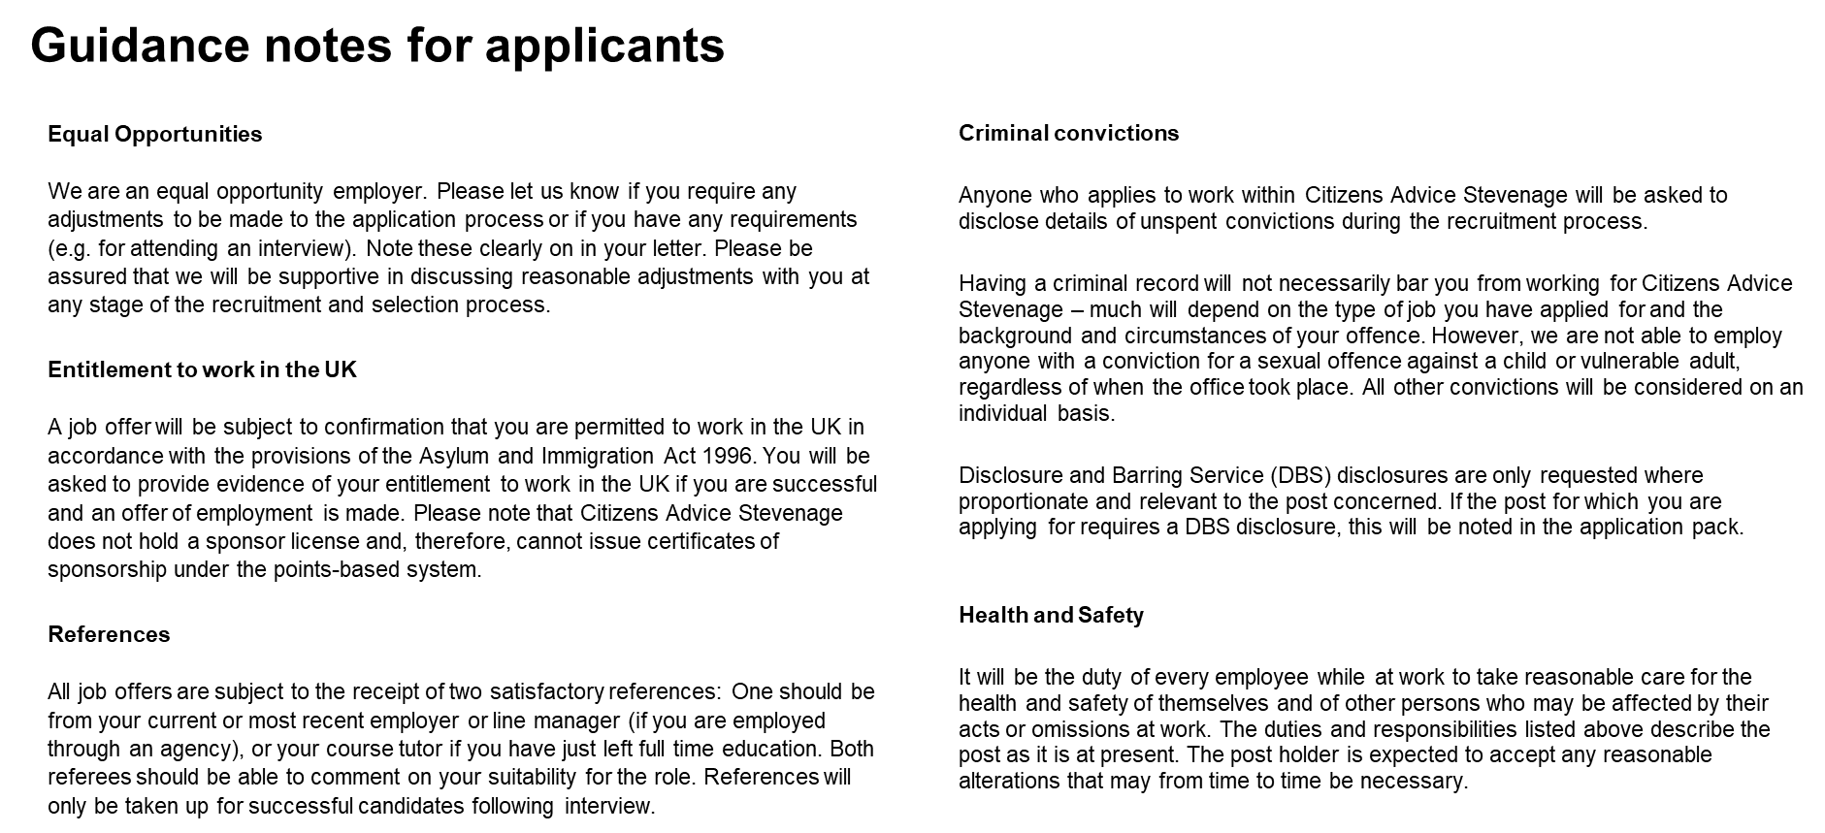

Slide 9
Addressing each point of the person specification
This is a key section of the application which allows you to provide evidence of your experience, knowledge, skills and abilities that are relevant to the role as described in the role profile. Selection is based on an assessment of the evidence you provide against the requirements of the role as set out in the person specification. It is important that you tailor your response to clearly demonstrate how you meet each requirement. No assumptions will be made about your achievements and abilities.
Please provide one example for each requirement. You should choose examples of past experience that clearly demonstrate what we are looking for, and be precise about what you did, how you did it and the outcome or result of your actions. Please try to limit your response to each criterion to a maximum of 200 words.
A useful guide might be S.T.A.R:
Specific – give a specific example
Task – briefly describe the task/objective/problem
Action – tell us what you did
Results – describe what results were achieved
Please provide recent work examples wherever possible. However, do remember that relevant examples from other aspects of your life, for example: voluntary or unpaid work, school or college work, family or home responsibilities, can also be given.

